Slide 1
Quantum Adiabatic Theorem test
Authors: Carles Esteve Boncompte
Georgios Stylianou

Slide 2
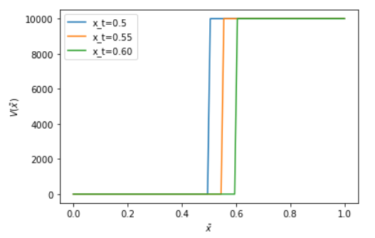
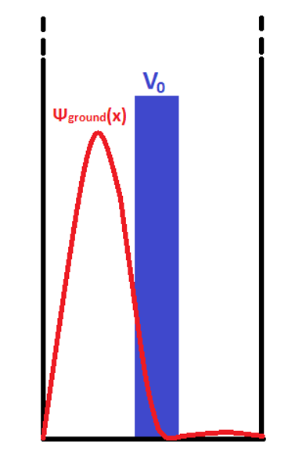
Research question
Test of the Quantum Adiabatic Theorem
Simulation of two different simple quantum systems (based on examples and problems of [1])
System 1
System 2

Slide 3
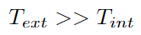
Theoretical background
A quantum system will evolve adiabatically if time order of magnitudes obey
Analysis of our system:
Qualitative: looking at the wavefunction
Quantitative: looking at the energies

Slide 4
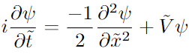
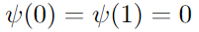
Units
In both of our implementations these general considerations hold:
Variables are dimensionless and are expressed in units of the natural magnitudes of the problem
New Schrödeinger equation
Boundary conditions read for both systems (infinite potential well)

Slide 5
Implementation
Eigenproblem of the initial potential landscape is solved. We obtain the eigenfunction and eigenenergy of the ground state
We take this ground state and we let it evolve in a time dependent potential
We obtain a final wavefunction
We study the energy of the system and the wavefunction and we compare it with respect to the eigenproblem of the final potential landscape

Slide 6
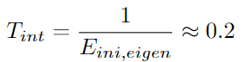
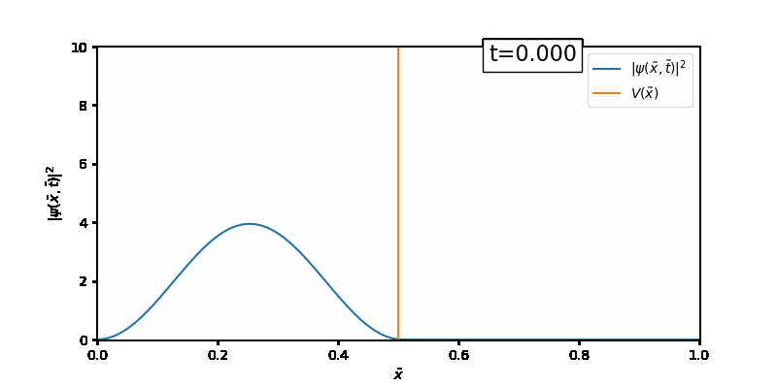
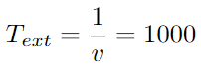
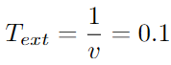
Results for quantum system 1
We let our eigenfunction of the initial potential landscape evolve with potential moving at (left panel) and (right panel)

Slide 7
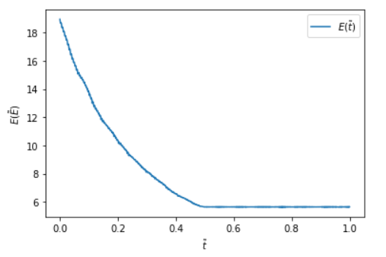
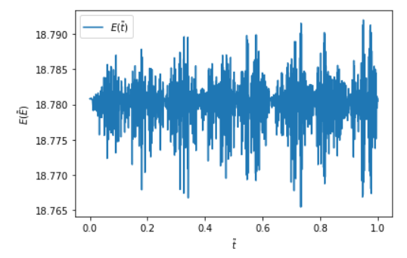
Results for quantum system 1
We obtain the energy evolution for both cases
We extract the mean value of the energy taking a mean over the energies in equilibrium state

Slide 8
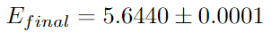
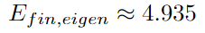
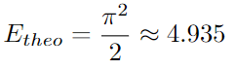
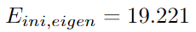
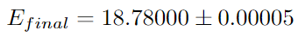
Results for quantum system 1
We compare the energies
Final energy of the adiabatic evolution with the energy of the ground state of the final potential landscape eigenproblem
Final energy of the non-adiabatic evolution with the energy of the ground state of the initial potential landscape eigenproblem
These two comparisons have to give energies similar to each other

Slide 9
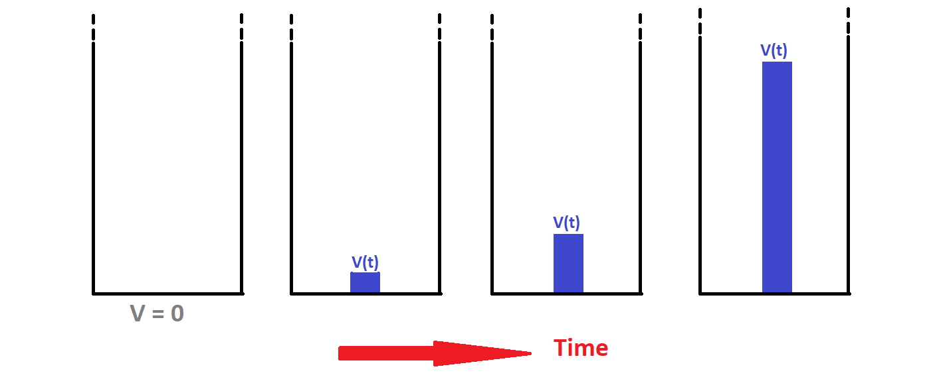
Quantum system 2: Splitting Well
Problem setting:
L/2 +
L/2 -
L

Slide 10
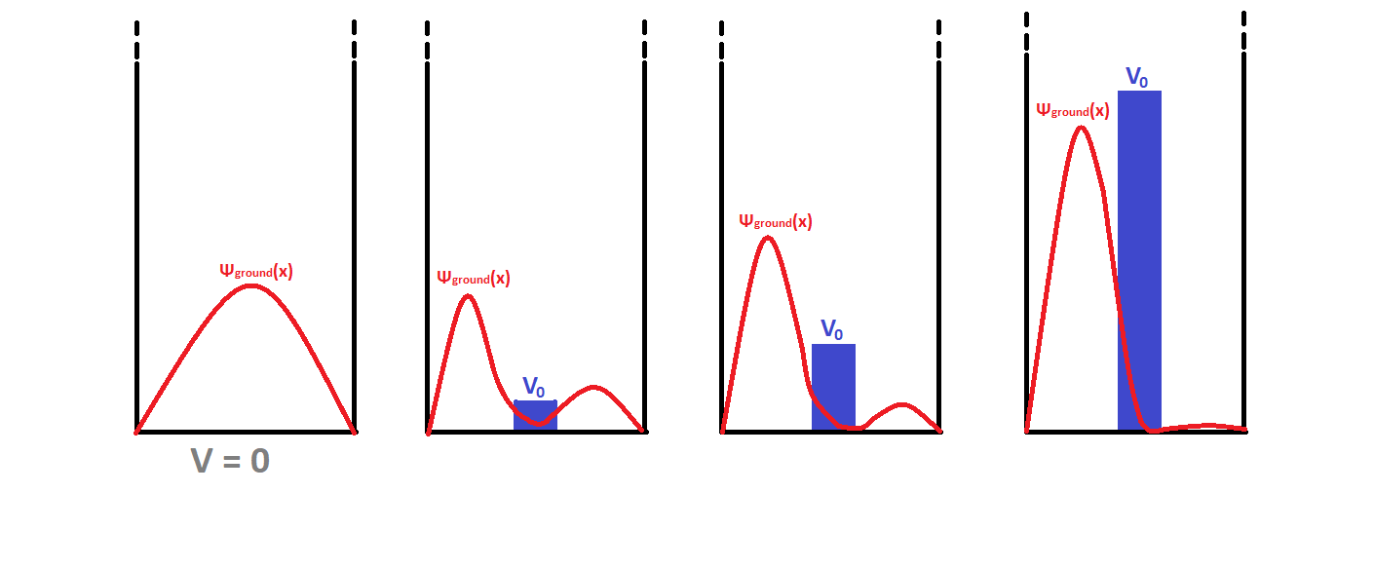
Quantum system 2: Splitting Well
Expected stationary states: Confinement in L/2+ !

Slide 11
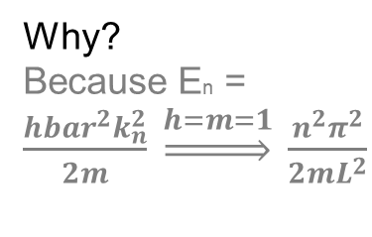
Quantum system 2: Splitting Well
Why?
Because En = $\frac{{hbar}^{2}k_{n}^{2}}{2m} \underset{⇒}{h=m=1} \frac{n^{2}π^{2}}{2mL^{2}}$
Expected stationary states:
L/2 -
L/2 +

Slide 12
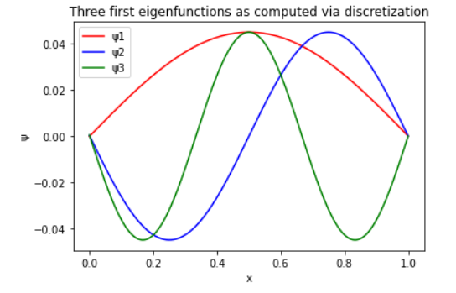
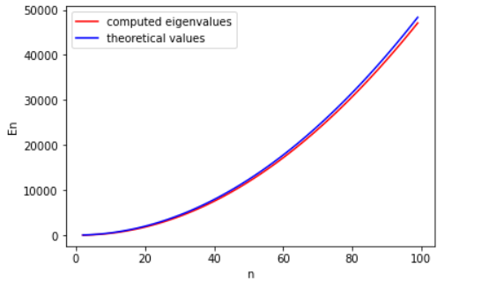
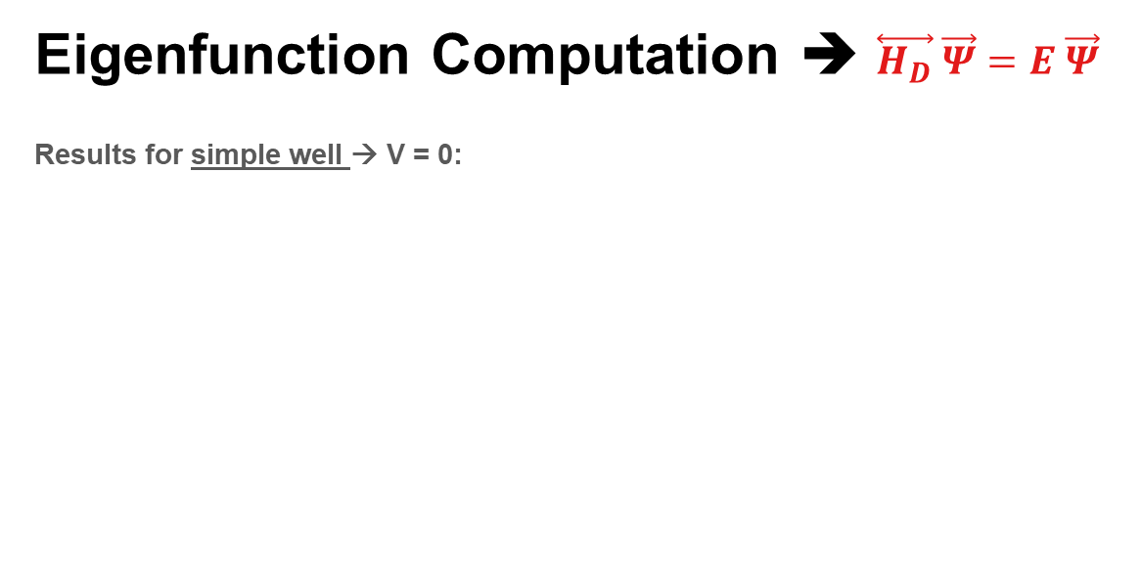
Discretization (Stationary eigenfunctions)
Eigenfunction Computation ➔ $\overset{⃡}{H_{D}} \vec{Ψ}=Ε \vec{Ψ}$
Results for simple well → V = 0:
Notes:
Eigenvalue problem. Discretization → makes Hamiltonian a matrix and the eigenfunctions multidimensional vectors. Each component of the WF-vector corresponds to the value of the function on a grid point.

Slide 13
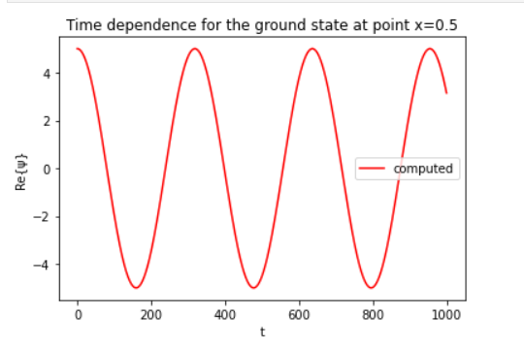
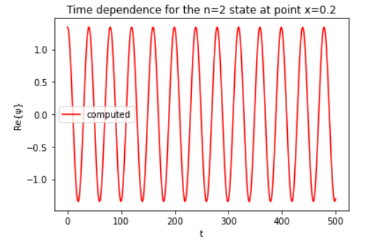

Time Evolution (Crank – Nicolson method)
$${\vec{Ψ}}^{n+1}={\left(2+iΔt {\overset{⃡}{H}}_{D}\right)}^{−1}\left(2−iΔt {\overset{⃡}{H}}_{D}\right){\vec{Ψ}}^{n}$$
Simple well stationary States ➔ Just a phase factor ➔ Re{ψ} ~ cos(Et)

Slide 14
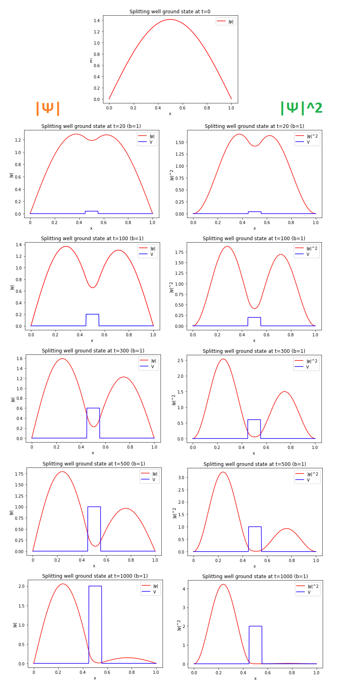
Splitting well implementation
Introduce V(t)
ADIABATIC!
Tint = 1/Eg = 40 – 200 timesteps
Notes:
All analysis in the 2nd part has been done for 1001 grid points and 1001 iterations

Slide 15
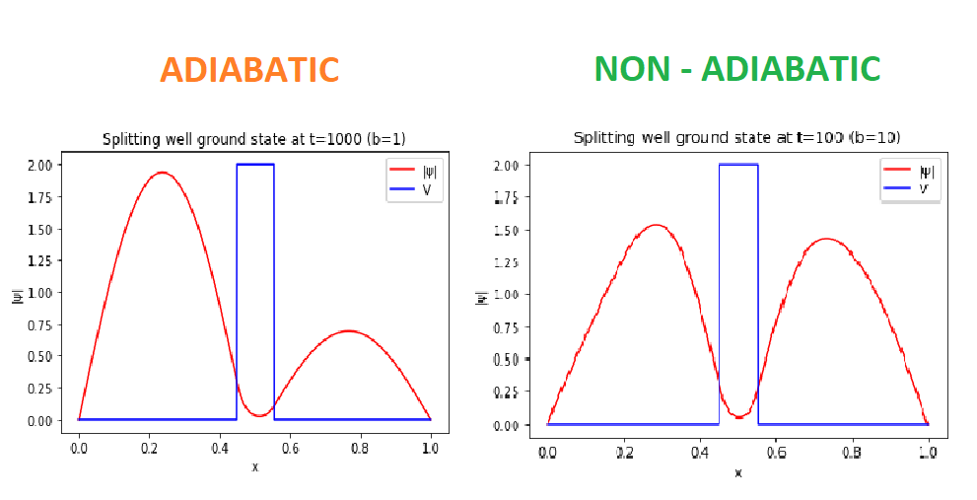
Adiabatic vs Non adiabatic
Text = 100Eg / b = 500 – 2000 timesteps
>> Tint
Text = 48 – 210 timesteps
~ Tint

Slide 16
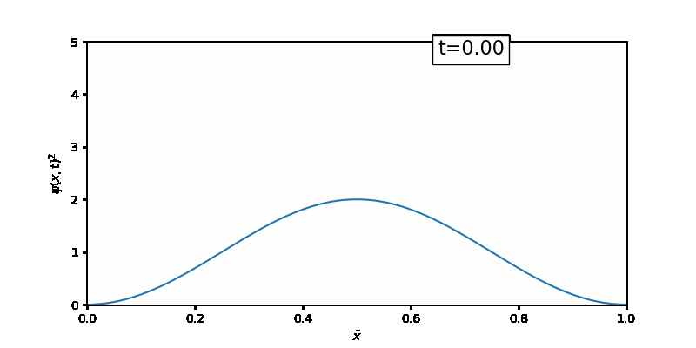
Adiabatic vs Non adiabatic
Adiabatic
(b = 4 ➔ Text = 125 – 500 timesteps)
Non Adiabatic
(b = 30 ➔ Text = 16 – 70 timesteps)

Slide 17
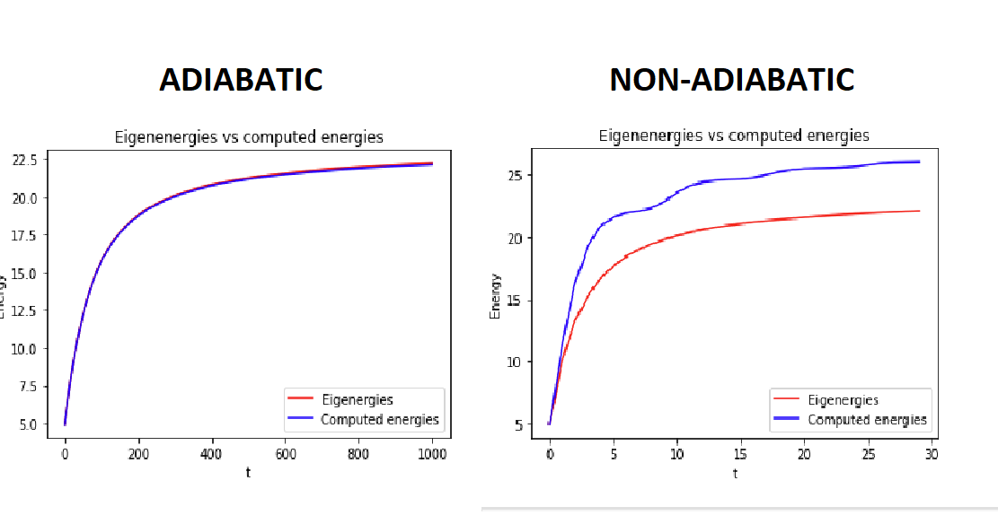
Energy Comparisons

Slide 18
Performance of the code
Crank - Nicolson implemented in two ways:
First System → Based on [2] ➔ Temporal & Spatial –for loops ➔ Time = 150s (N = 200 grid points)
Second System → Based on [3] ➔ Temporal –for loop only ➔ Time = 6s (N = 200 grid points), Time = 473s (N = 1000 grid points)

Slide 19
Conclusions
We have been able to reproduce satisfying results for the adiabatic time regimes
We have been able to verify it either qualitatively and quantitatively and throughout two different systems

Slide 20
Bibliography
[1] D. J. Griffiths, “Introduction to Quantum Mechanics,’ 2nd Edition, Pearson Educ. Int., (2005)
[2] Koonin, S.E. (1990). Computational Physics: Fortran Version (1st ed.). CRC Press.
[3] Gea-Banacloche, ‘‘Splitting the wave function of a particle in a box,’’ Am. J. Phys. 70, 307–312 (2002)

Slide 21
Thank you for your attention
Question session

